Slide 1
Welcome to fourth grade!

Slide 2
About me!

Slide 3
Google Classroom
Sign up for your kids account so you are connect.

Slide 4
hOUSEKEEPING
PLEASE COMPLETE THE STUDENT CONTACT FORM, MAKE ANY CHANGES, AND SIGN

Slide 5
Supplies
CLARIFICATION/QUESTIONS

Slide 6
Morning procedures & commons
Commons on Mondays
7 Mindsets will follow

Slide 7
AGENDAS
EXPECTATIONS
Copy homework and upcoming assessments in their agendas every day
Teacher will initial
Parents should initial each night after reviewing assignments

Slide 8
Homework!
Will be used to reinforce skills learned in the classroom
Should be a mixture of online and paper/pencil assignments
Should take around 40 minutes total each night
Please contact me immediately if homework is taking an excessive amount of time or seems to be a struggle for your child.

Slide 9
Missing Assignments Recovery
Recovery is only for tests and is not to exceed 70% on final score.

Slide 10
BYOT
What is BYOT?
BYOT contract for students and parents coming soon!
What if my child does not have a device?

Slide 11
Flexible seating!
Creates a student-centered learning environment
Allows multiple classroom areas for student collaboration
Helps students stay active during the school day
Provides an environment for active learning

Slide 13
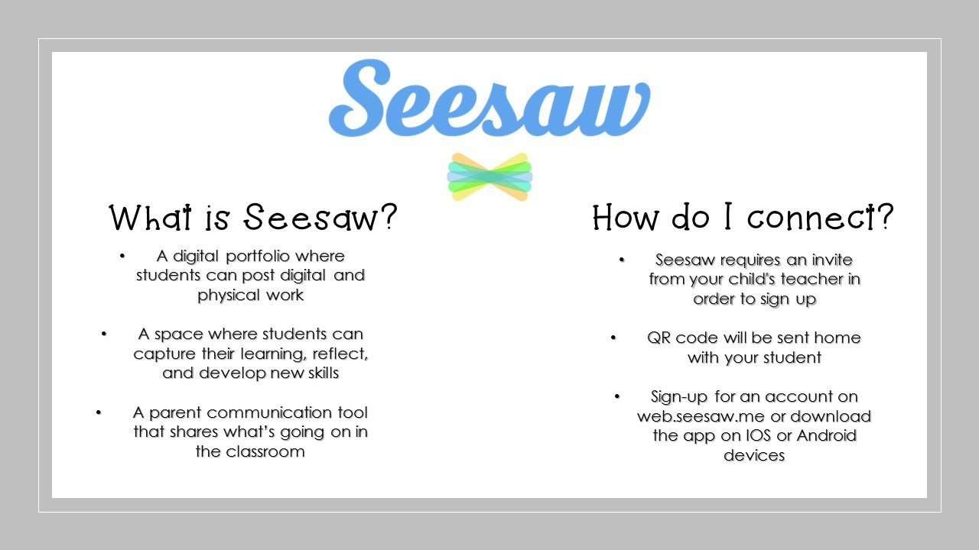

Slide 14
Google Classroom
Students will have their own accounts to turn in assignments, complete quizzes and tests, and to look for notes.
Student knows their login information
These accounts can be accessed at home as well.
Students can login in directly or use launchpad.

Slide 15
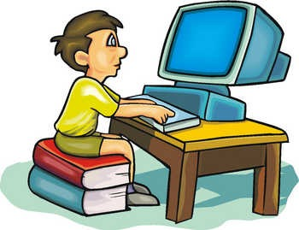
RELA NOTEBOOKS and website!
Help students learn how to organize information
These will be kept at school
The same resources will be posted to our websites and/or Google Classroom.

Slide 16
THANK YOU!
PLEASE LEAVE THE COMPLETED STUDENT INFORMATION SHEET
YOU CAN NOW MOVE TO YOUR CHILD’S PM BLOCK CLASSROOM
WE ARE LOOKING FORWARD TO A GREAT YEAR!

