Slide 1
TEXT FEATURES AND TEXT STRUCTURES
BY: JACOB DEAL

Slide 2
Text features
The text features are title, title page, table of contents, index, glossary, heading, photograph, illustration, caption, labels, graph, table.

Slide 3
Title
The name of a passage.

Slide 4
Title page
The page that talks about what the passage is going to be about.

Slide 5
Table of contents
It tells the name of the chapters and what page they can be found on.

Slide 6
Index
Tells where specific topics can be found.

Slide 7
Glossary
Tells the definition of the words in the book.

Slide 8
Photograph
Shows what something looks like by a camera.

Slide 9
Illustration
An artist impression of something.

Slide 10
Caption
Explains what a photo or illustration is about.

Slide 11
Labels
Tells the names of certain parts of a photo or illustration.

Slide 12
Graph
Organizes and compares data.

Slide 13
Table
Organizes facts and numbers in a visual way so it is easier to read.

Slide 14
Text structures
Text structures are what the text is made of. There is sequence, compare and contrast, problem and solution, cause and effect, and description.

Slide 15
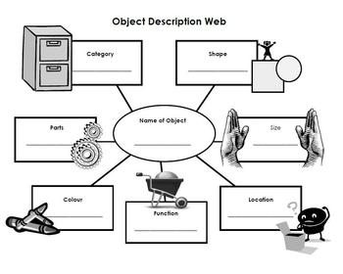
Description
Describe (adverbs and adjectives)
Main Idea
Details
Characteristics, features, examples

Slide 16
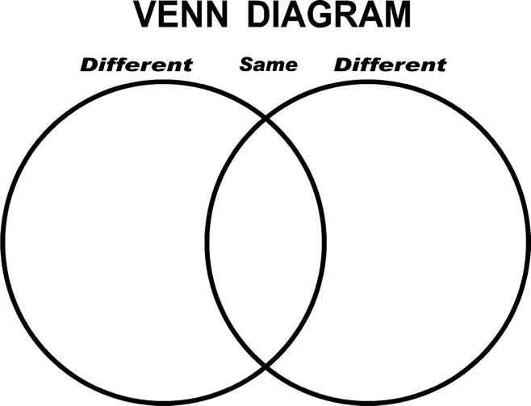
Compare & contrast
What is alike and what is different
Similarities & Differences
Use a Venn- Diagram

Slide 17
Sequence
First, next, then, last, before, after

Slide 18
Cause & effect
When something makes something else happen.

Slide 19
Problem & solution
A problem and a way to fix it.

Slide 20
Any questions?
The
end

