Slide 1
Study Guide
By: Lizzie
#12

Slide 2
Text Structures
There are 5 types of text structures.
Compare and Contrast
Problem and Solution
Cause and Affect
Description
Chronological Order

Slide 3
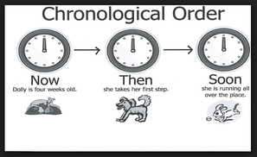
Chronological Order
Chronological Order tells you how to do something or how it changed like in history (through the ages, this is how you, ect.)
You can tell also by a timeline because it also shows events in order. Here are some keywords
First
Next Ex:
Later
Then
finally
or

Slide 4
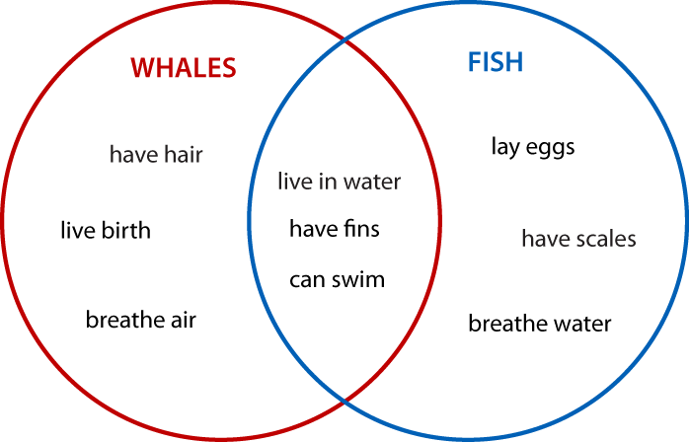
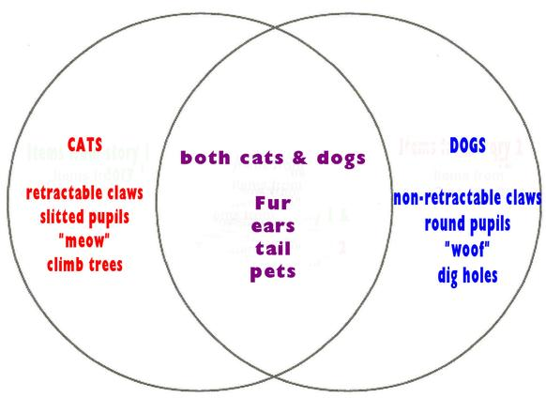
Compare and Contrast
Compare and Contrast is when you tell the differences and similarities between two things(nouns). You can use Venn diagrams. Here are some keywords
Both
But
Differences Ex:
While
On the other hand
or

Slide 5
Cause and Affect
Cause and Affect is when something happens and causes something else to happen. Look for keywords such as
Cause
Affect
Because of this
As a result
Consequently
So

Slide 6
Problem and Solution
Problem and solution is when there is a problem and then someone came up with a solution. Look for keywords such as
Problem
Solution
Threat
Difficulty
Hope
Answer
Possibility

Slide 7
Description
Description is only facts. Some keywords you might want to look for are
One reason
Another reason
For example
You can’t use words like
My
We
You
I
we
When you do description you have to explain something not compare and contrast something or tell how to do something.

Slide 8
Text Features
Text Features are stuff or features that the text has. They help you understand the text. Some of them are
Bold word
The table of contents
Glossary
Headings
Pictures
Labeled diagrams

Slide 9
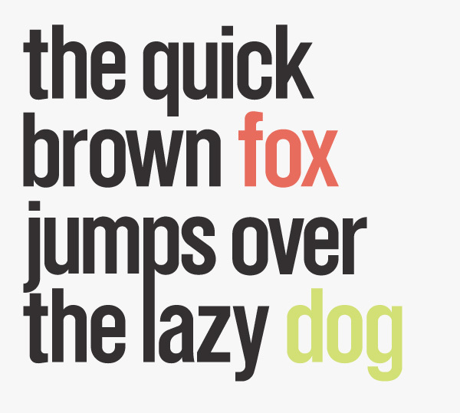
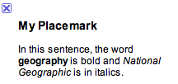
Bold Words
Bold words are words that are important. Bold words are always bold so you can find them easily. Bold words help know what the passage is about and the words that are important. Bold words are usually the keywords or vocabulary in the passage.

Slide 10
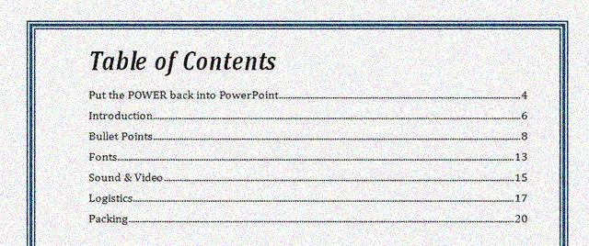
Table of Contents
The table of contents is a very important feature. In a book it tells you the chapters or the subject on each page. It helps you find the page, chapter, or subject you need. When you lose your page go to the table of contents.

Slide 11
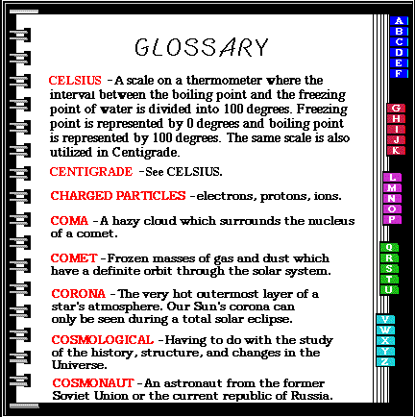
Glossary
The glossary explains what the bold words mean. The bold words are usually tricky so in the glossary it tells you what the bold words mean. People usually don’t understand the words so the glossary is there to help. The glossary is usually at the back of the book.

Slide 12
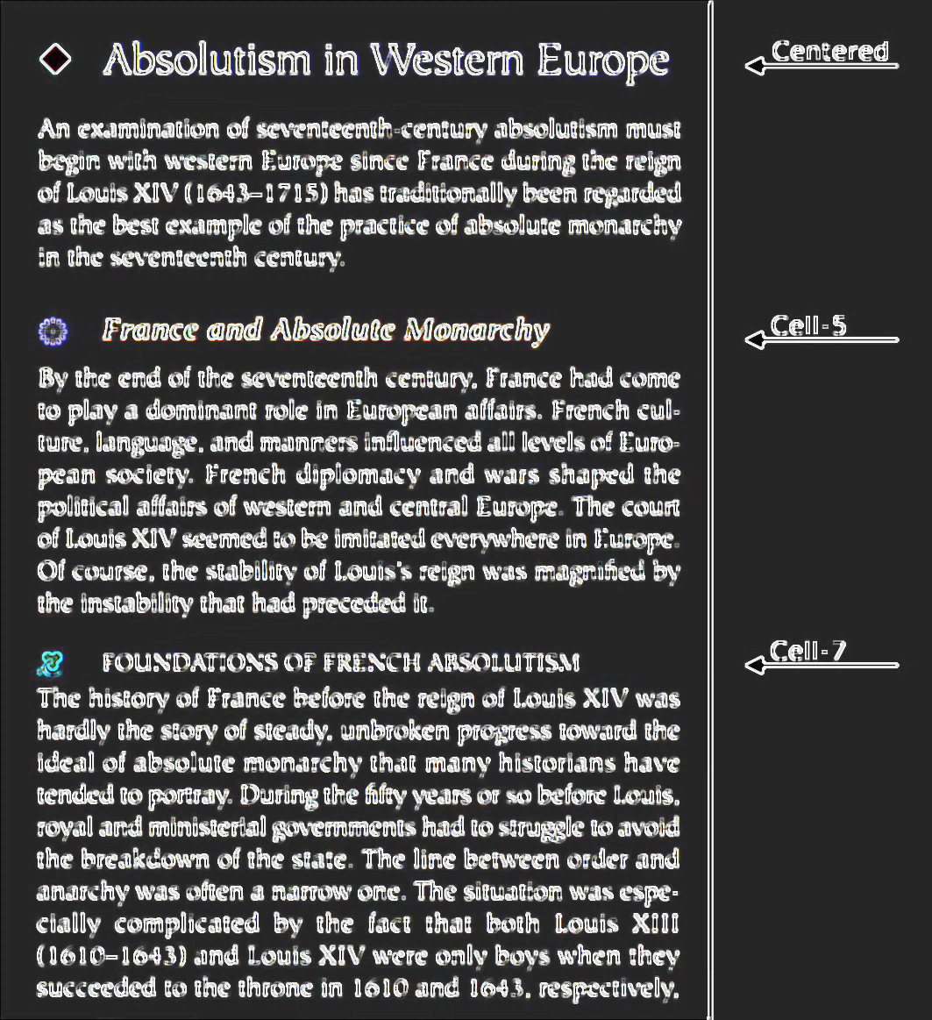
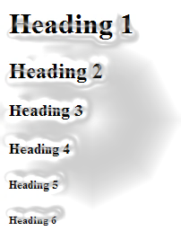
Headings
A heading is kind of like a subtitle. It is located at the top of the page. It helps you find what passage your looking for. It is not the real title.

Slide 13
Pictures
Pictures give you a idea of what it looks like in your brain. It helps you think. You can actually see what’s going on.

Slide 14
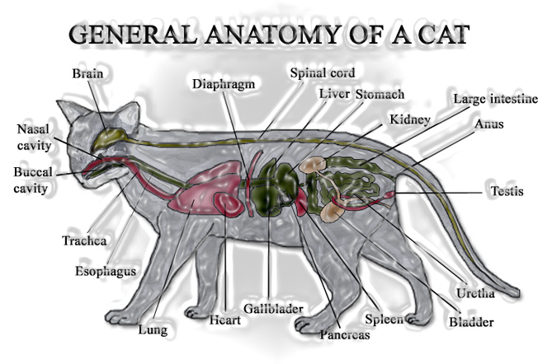
Labeled Diagrams
Diagrams tell you parts of something. They show where something is on something else. The diagram could be of a car with the labeled parts or of a body.

Slide 15
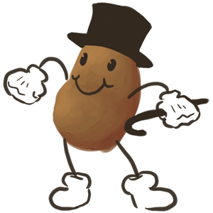
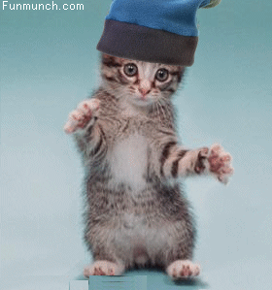
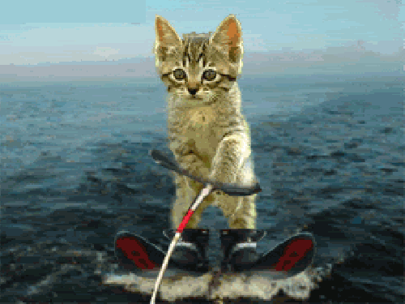
Hope you studied enough!

