Slide 1
Text Structures and Text features
By: Priyanka Kavdikar

Slide 2
Text structures
There are 5 types of text structures. They are: description, cause and effect, compare and contrast, problem and solution and order and sequence or chronological order

Slide 3
Description☺
Description is a text structure that describes something. Such as:
Winter in GA is not super freezing cold but an okay winter. Snow never really falls here either. Usually it’s just cold so you can wear a warm, thick jacket. If snow does fall, then is cold but you don’t get as much snow as you would get in North Dakota or Virginia. This how winter is in GA.
* * *
See how it is describing how winter is in GA? It’s not saying things like how where GA is effects winter in GA . Now let’s move on.
☺☺☺

Slide 4
Cause and Effect☺
Cause and effect is pretty simple. It is because of the cause the effect came out.
Such as:
Because of where GA is we get a pretty hot summer. GA is in the south of the U.S.A. The effect of living down here is that we get really hot Summers. It is very hot between 1:00-4:00. It gets hot after that and then we have mild nights.
Key words are: Because and Effect
☺☺☺

Slide 5
Compare and Contrast☺
Compare and contrast is comparing and contrasting two or more things.
Such as:
Winter and summer in GA are different and similar in their ways. For example in Summer it is really hot and in winter it’s really cold. They are also different because in summer all the tree’s are full with leaves and the flowers have bloomed however, in winter the tree’s are bare with no leaves and you can’t see any flowers. They are also similar too. For instance both winter and summer are both seasons and they are both caused by the sun.
Key words are: Different, compare, contrast, and both
☺☺☺

Slide 6
Problem and Solution☺
In problem and solution there is problem and there is a solution.
Such as:
We make lot’s of pollution and this hurts the environment badly. We can solve this problem by picking up litter and cleaning streams we can use less gas cars and more electric cars. We can also cut less tree’s and make less buildings out of wood. We can conserve things such as water. We can truly stop this pollution by working together.
Key words are: problem, solution
☺☺☺

Slide 7
Order and sequence/Chronological order
Order and sequence is showing the order of things.
Such as:
Do you want to make a fortune teller? Well, let’s get started!
First you need a piece of paper. Now fold it and cut it so that it is a square. After, fold it around the corners so that there are 4 little triangles. Then, flip the paper over and make ,again, folding the corners so that there are 4 triangles. If you flip it over you should have 4 squares. Then, on the 4 squares, put different words or colors. On the inside put numbers. And, finally put things like ”Truth or Dare!” or “Draw a Giraffe!” and such things. Now you have a complete fortune teller!
Key words are: First, next , last , finally, and after
☺☺☺

Slide 8
Text Features☺
Text Features
Are features
That help you
Understand the
Text. They are
Bold prints, colored
Texts, italics, Diagrams, maps, tables and
Charts, pictures and captions,
Bullet points, and subtitles
headings, and titles.

Slide 9
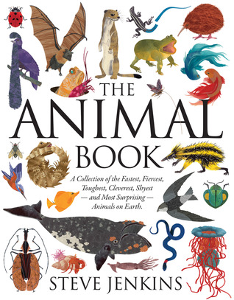
Titles☺
This is also a title because it indicates what this slide is going to be about. ☺
indicate what the text is going to be about. For instance, if you wanted a book about animals then you would look at the title to know if the book is about animals or not. If you looking for something more specific like polar bears, then you would have to find a title about polar bears.
Titles
This is a title because it indicates what the book is about ☺

Slide 10
Bold Prints, Italics, And Colored Prints
Bold prints are usually to specify an important word such as “Specify” This lets you know that it is an important word and that you might want to go to the glossary to find out what the word means.
Italics are usually to emphasize a word or put someone's thoughts in there such as “it was so boring.” The underlined word is the italics word it shows thoughts and it emphasizes the word.
Colored prints can show highlighted words and words that, also, you need to look up in the glossary. Such as, “it was Daybreak when we saw our puppy” The word daybreak is highlighted to show that it is a word that you probably don’t know.

Slide 11
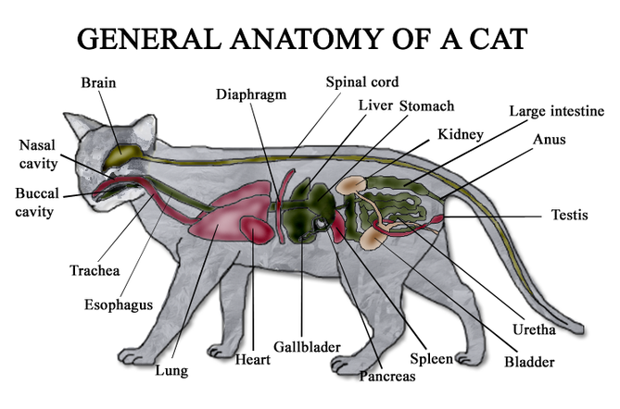
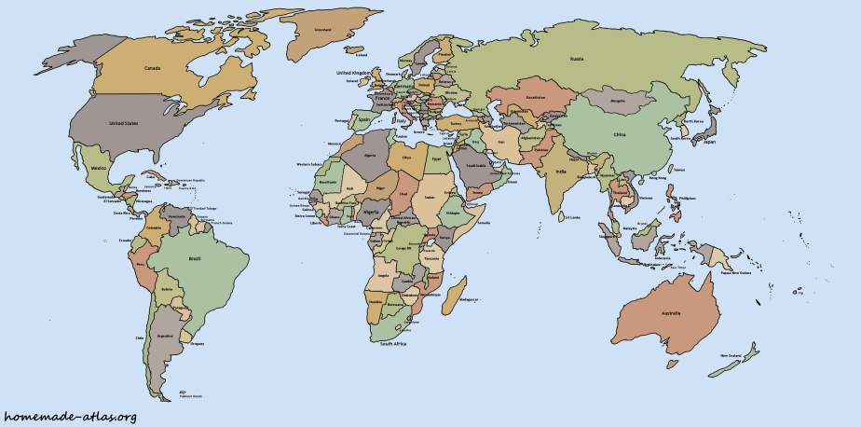
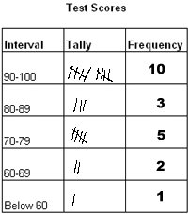
Diagrams, Maps, and Tables
A diagram is something that is a visual so that you cacn clearly see the information. If you wanted to see a cat this is what you would see.
This is a map. Maps also area visual aid that help you see exactly what they are talking about.
This is a table it helps you see information in a way so it is grouped together

Slide 12
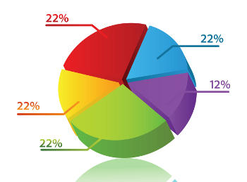
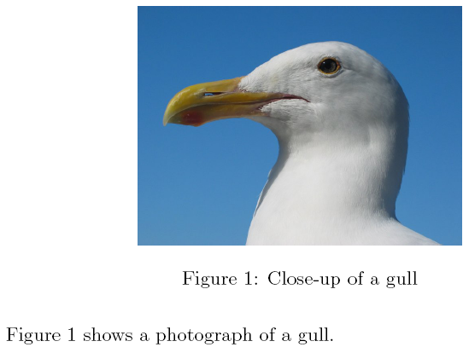
Charts, pictures and captions, Bullet points, and subtitles headings
Charts help a reader group information together so they don’t get confused.
This is a picture with a caption
Bullet points help a reader process information at one time.
They help readers
Did you know these are bullet points?
Headings help a reader know what this section is going to be about. Such as “Diet”
Subtitles help a reader Indicate exactly what it is about.

Slide 13
