Slide 1
Staying Focused
While Writing
Informational
Essays
Grade 4
Copyright © 2015 by Write Score LLC

Slide 2
Research Reports
A research report uses facts from outside sources to inform readers about a topic.
Today, we will use the internet to find answers to questions.

Slide 3
Modeled Instruction
Prewriting:
First, choose a topic you are interested in.
Next, conduct research about that topic, jotting down notes.
Create an outline to organize your report.

Slide 4
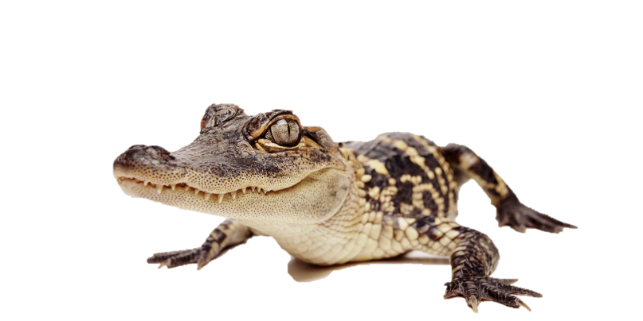
Modeled Instruction
Outline:
American alligator
Sometimes called a “gator.”
Florida’s state reptile
Threats to American alligators
Hunting – hunted for their meat and skin
Habitat loss due to urban sprawl
How American alligators were saved
State and federal protections
Habitat preservation efforts
Reduced demand for alligator products

Slide 5
Guided Instruction
Research Question:
How far away is the sun from Earth?
Key words for an Internet search:

Slide 6
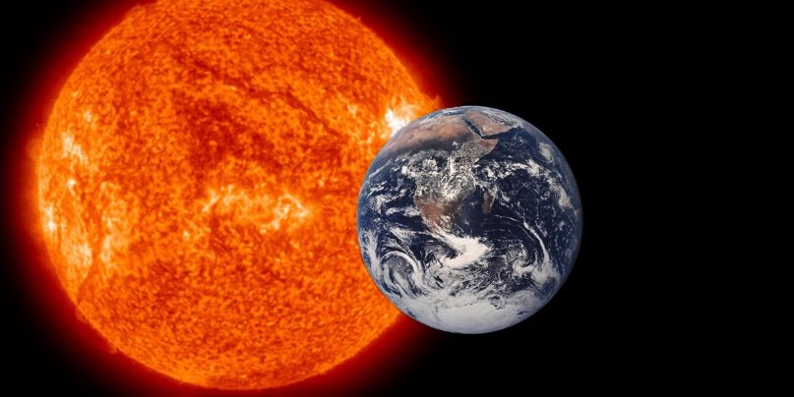
Guided Instruction
Research Question:
With your small group, come up with some questions.
Key words for an Internet search:
With your small group, come up with some key words for an Internet search.

Slide 7
Independent Practice
Choose another question.
Write key words to conduct an Internet search.

